Slide 1




NEXT GEN EMPLOYABILITY PROGRAM
Creating a future-ready workforce
Team Members
College Name
Student Name :Harish prabu .S
Student ID :au110321104014
Student Email ID : harishprabu2003@gmail.com
1103-GRT institute of engineering and technology

Slide 2

CAPSTONE PROJECT SHOWCASE
Project Title
MUSIC WEB APPLICATION USING DJANGO FRAMEWORK
Abstract | Problem Statement | Project Overview | Proposed Solution | Technology Used | Modelling & Results | Conclusion

Slide 3
Abstract Our music web application,built using the Django framework, aims to provide users with a seamless and immersive music listening experience. Leveraging Django's robust features and flexibility, we have developed a platform that caters to music enthusiasts of all genres. The application allows users to discover, stream, and organize their favorite songs and playlists, while also providing features for artists to showcase their work and engage with their audience. With an intuitive user interface, advanced search capabilities, and personalized recommendations, our Django-based music application promises to revolutionize the way users interact with music online. Key Points: User Authentication and Profiles: Implementing Django's built-in authentication system, users can create accounts, log in securely, and manage their profiles. This includes features such as profile customization, password management, and social authentication options for convenience. Music Library Management: The application offers a comprehensive music library where users can upload, store, and organize their music collections. Django's ORM (Object-Relational Mapping) facilitates efficient data management, ensuring smooth operations even with large volumes of music files. Streaming and Playback: Leveraging Django's capabilities for handling media files, our application enables seamless streaming and playback of music tracks. Users can enjoy high-quality audio playback directly within the web interface, with support for playlists, shuffle, repeat, and other playback controls.
Source :

Slide 4
Problem Statement:
In the contemporary digital landscape, music consumption has shifted significantly towards online platforms. However, despite the abundance of music streaming services, there remains a gap in the market for a music web application that provides a tailored and immersive experience for users and artists alike. Existing platforms often lack certain features or user-friendliness, leading to dissatisfaction among users and limited opportunities for artists to connect with their audience effectively. Therefore, the challenge is to develop a comprehensive music web application using the Django framework that addresses these shortcomings and offers a solution that meets the needs of both music enthusiasts and creators.
Source :

Slide 5
Project Overview
In the realm of digital music consumption, existing web applications often fall short in delivering a cohesive and satisfying experience for both users and artists. Current platforms lack the sophistication needed to seamlessly connect listeners with their favorite music while also providing artists with the tools necessary for effective promotion and engagement with their audience. Issues such as convoluted user interfaces, limited customization options, and inadequate support for artist collaboration hinder the overall music listening experience. Additionally, concerns regarding licensing and copyright compliance pose significant challenges for ensuring the legal distribution of music content. Therefore, the primary challenge lies in developing a music web application using the Django framework that addresses these shortcomings and offers a comprehensive solution tailored to the needs of users and artists alike. This entails creating an intuitive and user-friendly interface for discovering and streaming music, implementing robust features for artist promotion and engagement, and establishing mechanisms to ensure compliance with licensing agreements and copyright regulations. By tackling these challenges head-on, the aim is to revolutionize the way users interact with music online, providing a platform that fosters a vibrant community of music enthusiasts and creators.
Source :

Slide 6
Proposed Solution
To address the challenges outlined in the problem statement, our proposed solution entails the development of a sophisticated music web application using the Django framework. Leveraging Django's powerful features and flexibility, we aim to create a platform that offers a seamless and immersive music listening experience for users while providing comprehensive tools for artists to showcase their work and engage with their audience effectively.
Source :

Slide 7
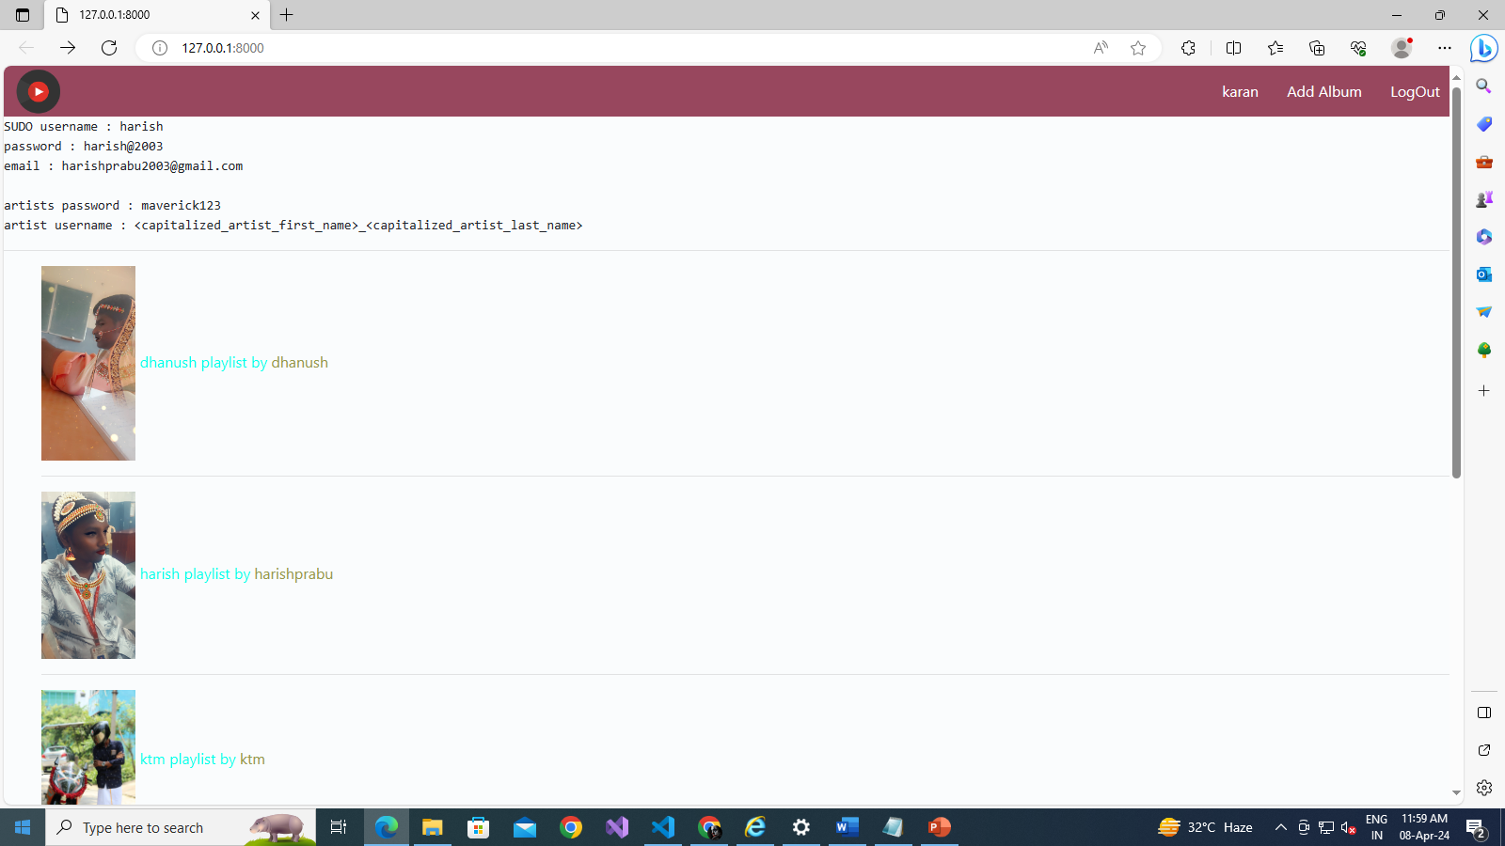
Source :

Slide 8
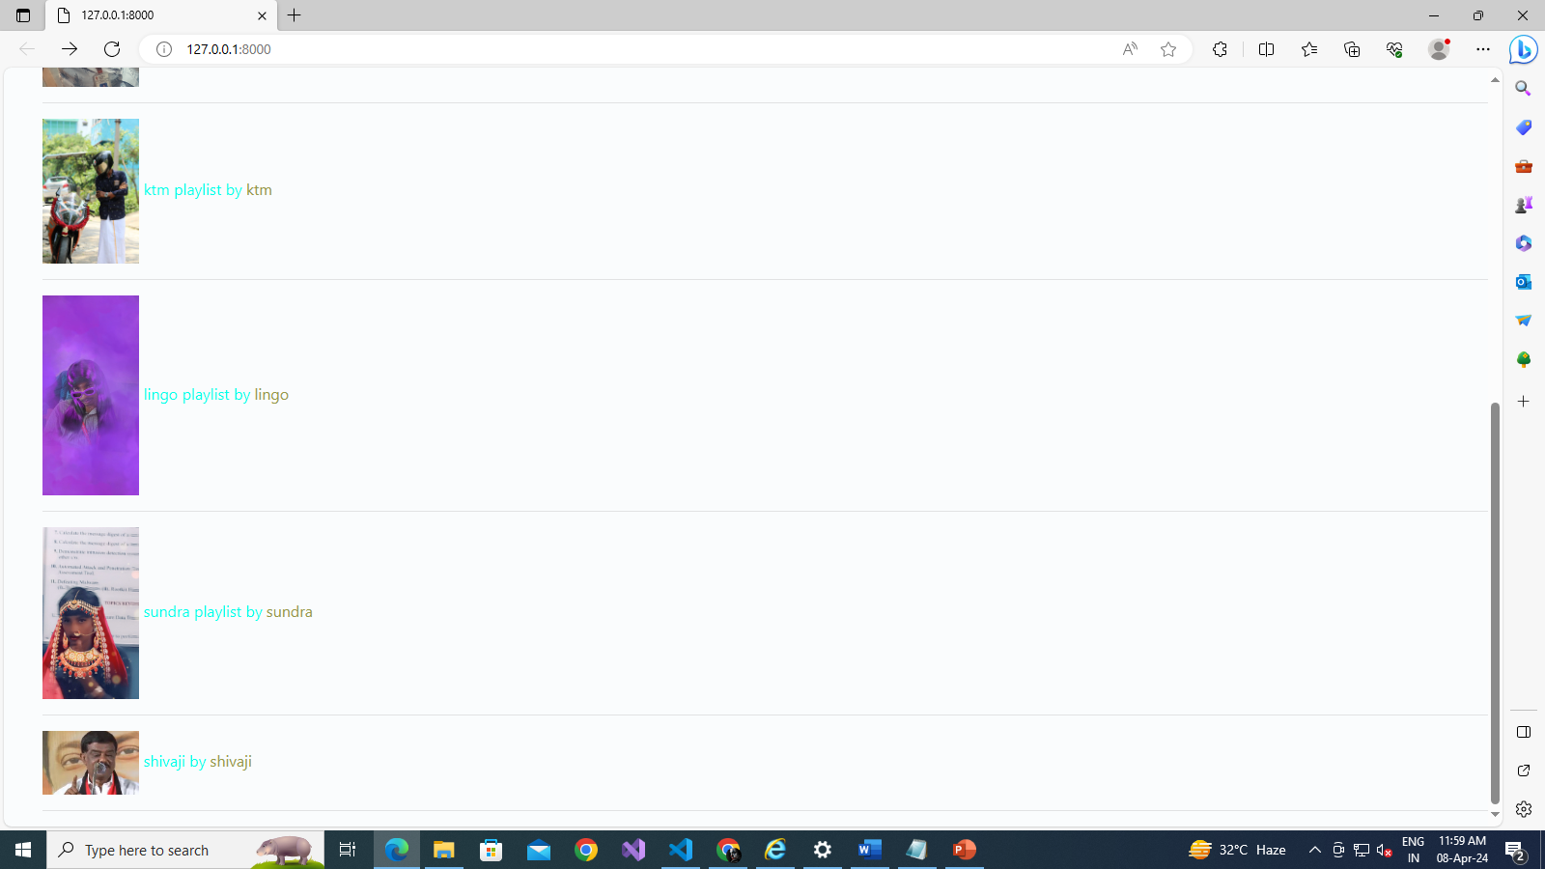
Source :

Slide 9
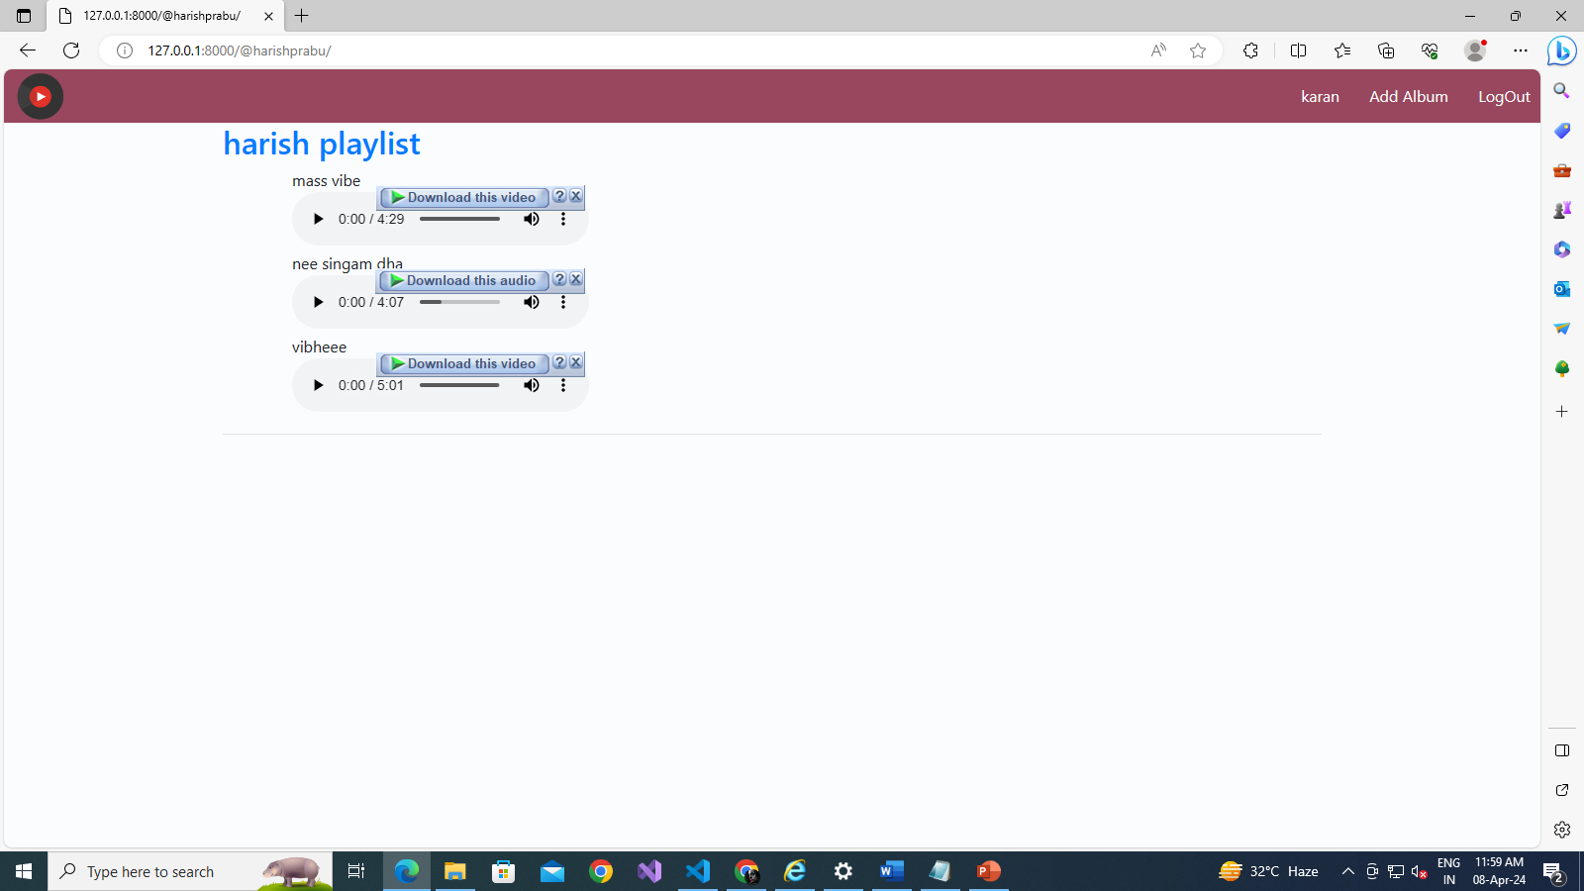
Source :

Slide 10

Source :

Slide 11
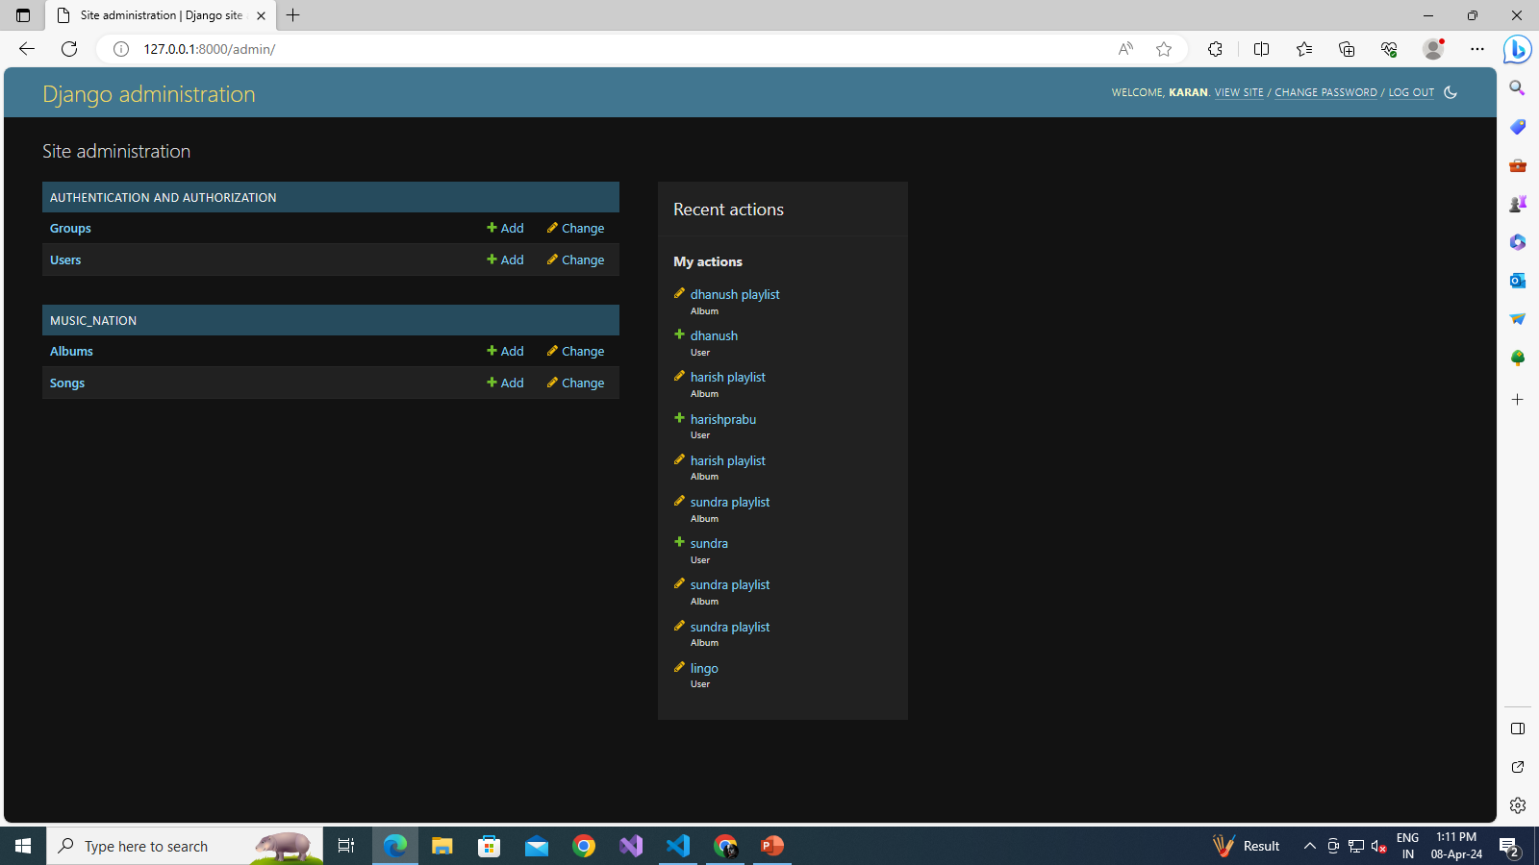
Source :

Slide 12
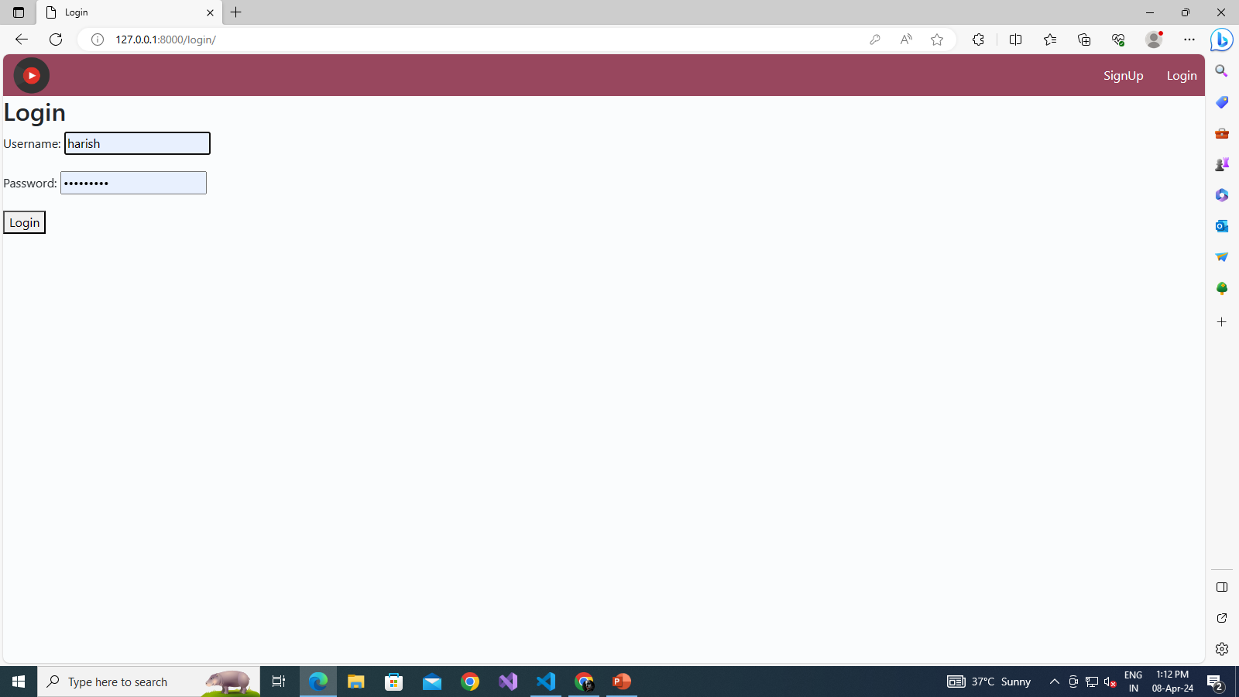
Source :

Slide 13
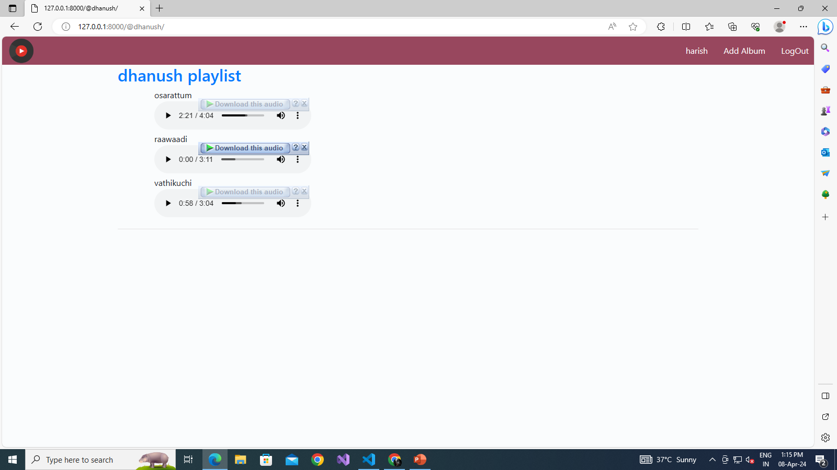
Source :

Slide 14
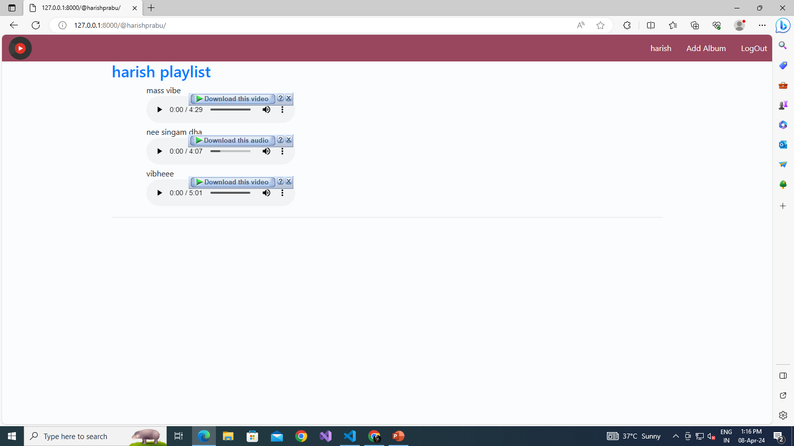
Source :

Slide 15
Source :

Slide 16
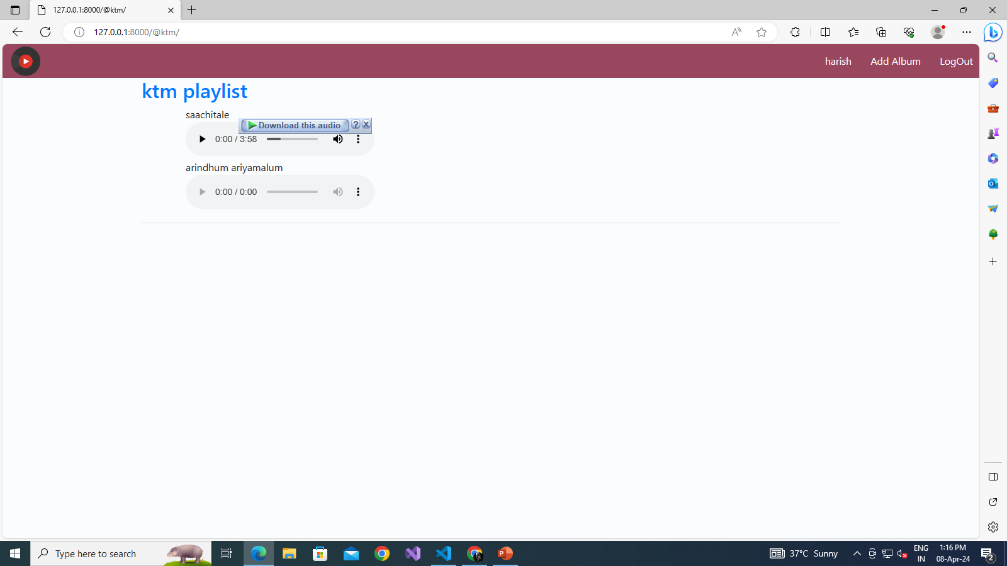
Source :

Slide 17
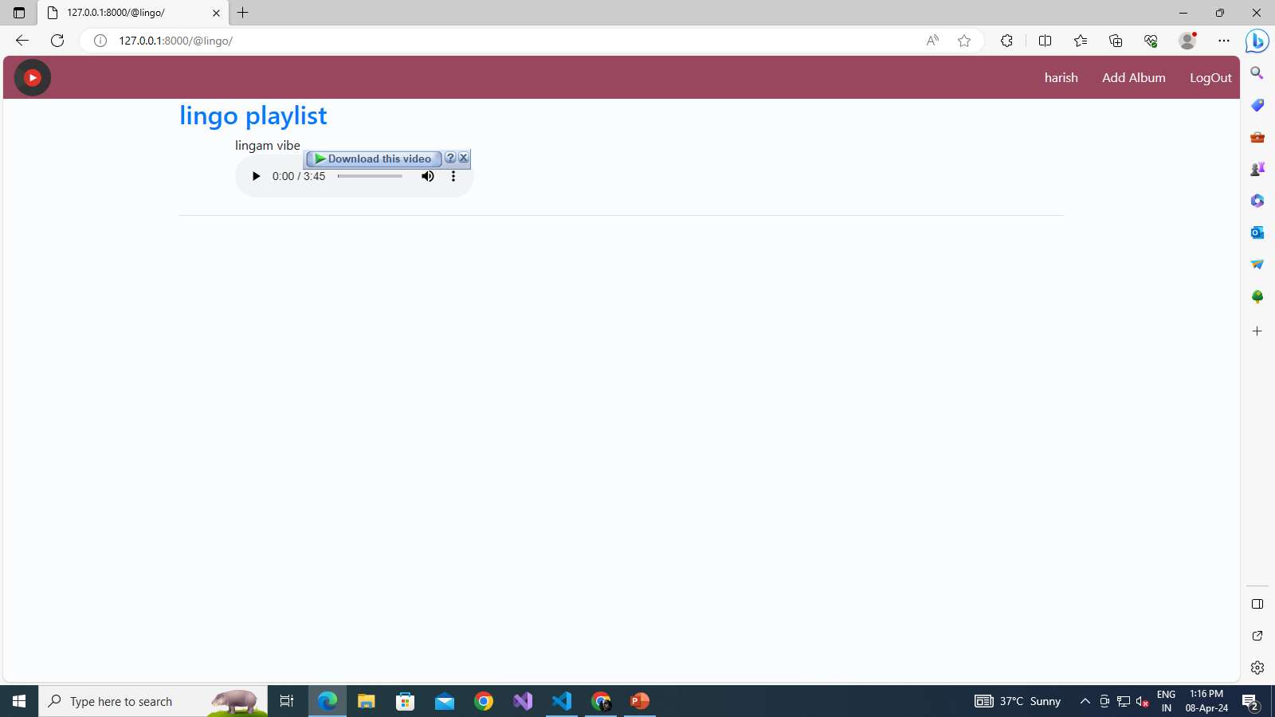
Source :

Slide 18
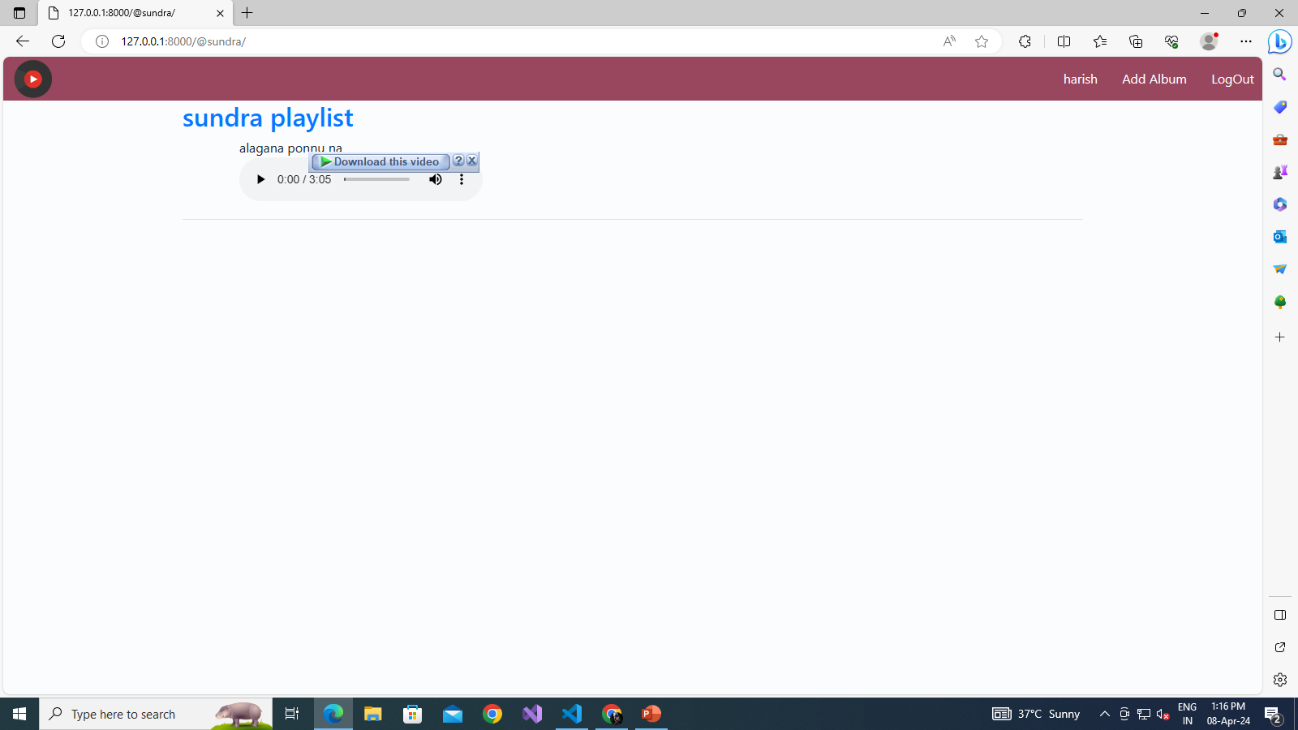
Source :

Slide 19

Source :

Slide 20
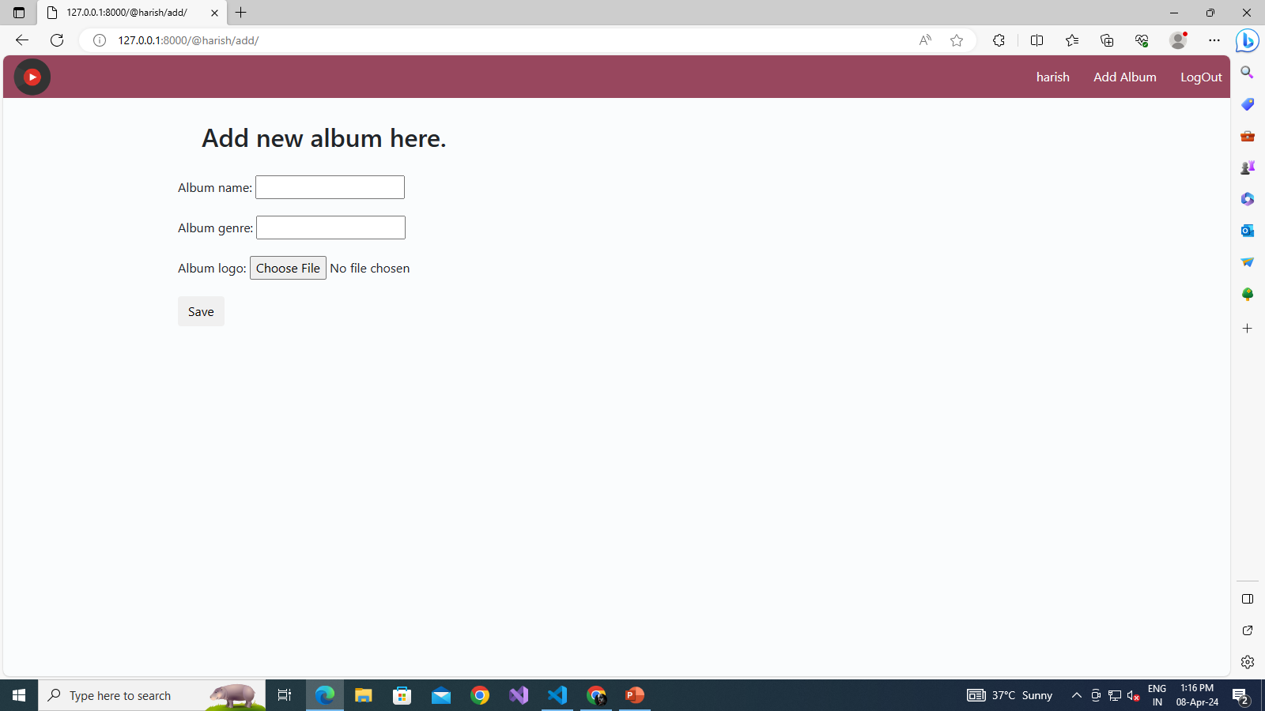
Source :

Slide 21
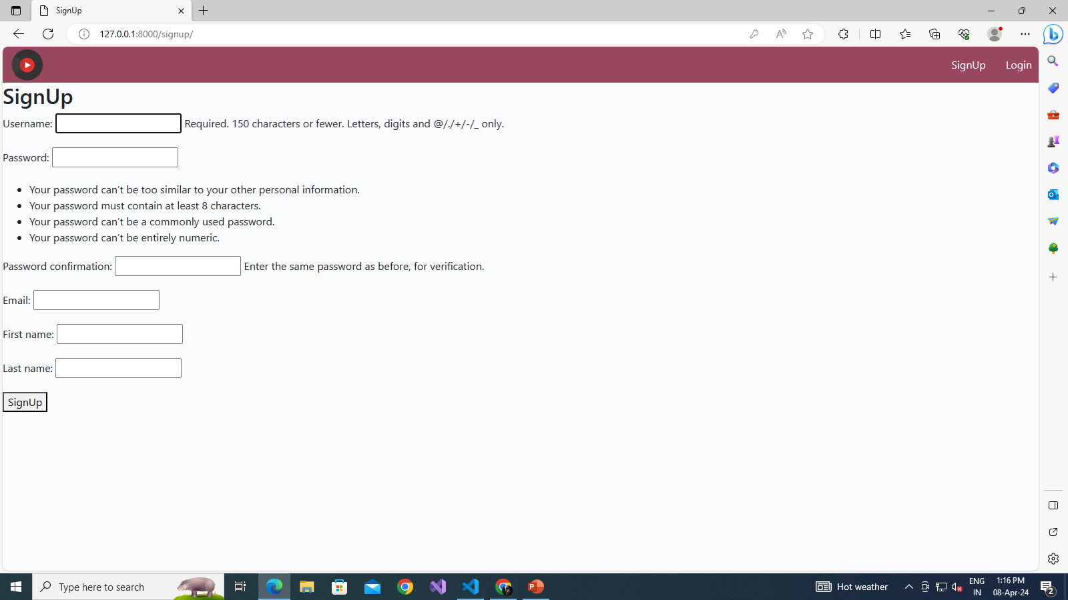
Source :

Slide 22
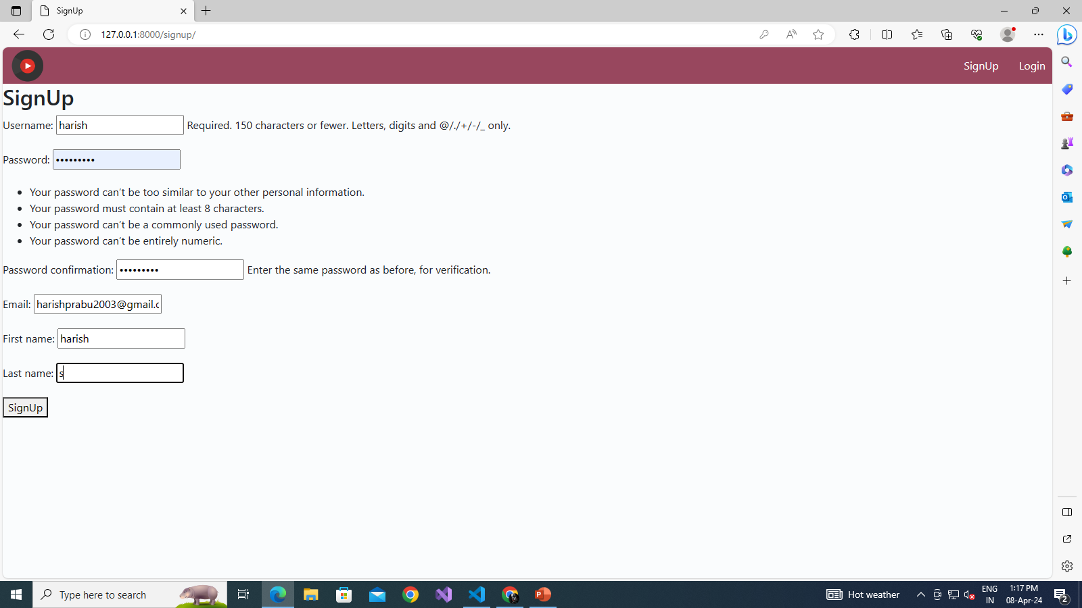
Source :

Slide 23


Technology Used
Front-end
Back-end
Source :

Slide 24
Modelling & Results:
In developing a music web application using the Django framework, the process of modeling and presenting results involves several key steps to ensure functionality and user satisfaction. Initially, the modeling phase encompasses the design of database models to organize data efficiently. These models may include entities such as users, songs, albums, playlists, and genres, each defined with appropriate fields and relationships to represent the application's domain accurately. With Django's built-in ORM (Object-Relational Mapping), these models can be translated into database tables effortlessly, facilitating seamless data manipulation and retrieval.
Following model creation, implementing functionalities to retrieve and present music-related results becomes paramount. Utilizing Django's views and templates, developers can define logic to process user requests and render dynamic HTML pages. For instance, users might search for songs based on titles, artists, or genres, triggering corresponding queries to fetch relevant data from the database. Similarly, functionalities such as creating playlists, favoriting songs, or accessing personalized recommendations can be implemented using Django's powerful view system, incorporating business logic to tailor user experiences.
Furthermore, integrating external APIs or libraries can enhance the application's capabilities. For example, leveraging music metadata APIs can enrich song listings with additional information like album artwork, release dates, or artist bios. Additionally, incorporating third-party services for features like music streaming or lyric display can enrich user interactions and provide a comprehensive music experience.
Source :

Slide 25
Homepage

Slide 26
About-Us-Page
In a music web application using the Django framework, the "About Us" page serves as a platform to convey essential information about the application, its creators, and its mission. Here's a breakdown of the key components typically found on the "About Us" page:
Introduction to the Application: The page begins with a brief introduction to the music web application, providing users with an overview of its purpose and features. This section may highlight the application's unique selling points, such as its extensive music library, personalized recommendations, or user-friendly interface.
Mission Statement: A mission statement articulates the goals and values that drive the development of the music web application. It communicates the team's vision for the application and its commitment to delivering a superior user experience. This statement may emphasize aspects such as accessibility, diversity, innovation, or community engagement.
Team Members: The "About Us" page typically includes information about the individuals or team behind the development and maintenance of the application. This section may feature brief biographies or profiles of key team members, including developers, designers, and other contributors. Users may appreciate learning about the people responsible for creating and maintaining the platform.

Slide 27
Service-Page
In a music web application built on the Django framework, the server page serves as the backend infrastructure that handles various requests from users and processes data to deliver dynamic content. Here's a breakdown of the functionalities and components typically found on the server page:
Request Handling: The server page processes incoming requests from users, which can include actions like searching for songs, creating playlists, playing music, or accessing user account information. Django's views handle these requests, executing the necessary logic to fulfill user requirements.
Data Processing: Upon receiving a request, the server page interacts with the database to retrieve, update, or manipulate data as needed. This may involve querying the database to fetch song details, user preferences, playlist contents, or other relevant information. Django's ORM simplifies database interactions, allowing developers to work with models and perform CRUD (Create, Read, Update, Delete) operations efficiently.
Business Logic: The server page contains business logic that governs the behavior of the application. This logic determines how user requests are handled, what data is retrieved or modified, and how responses are generated. For example, when a user creates a playlist, the server page validates the input, updates the database accordingly, and sends a confirmation message to the user.

Slide 28
Departments-Page
In a music web application developed with Django, a "Departments" page might be less common compared to other types of pages like the home page, search page, or user profile page. However, let's consider how such a page could be conceptualized within the context of a music-related platform:
Introduction to Departments: The Departments page serves as a hub where users can explore different categories or genres of music available on the platform. This section introduces users to the various departments or categories offered by the application, such as Rock, Pop, Hip-hop, Classical, Jazz, Electronic, etc.
Department Listings: On this page, users are presented with a list of departments or genres, each accompanied by relevant information such as a brief description, notable artists or albums within the genre, and perhaps a sample playlist. This layout helps users navigate through different music genres and discover new music based on their preferences.
Featured Departments: Highlighting featured departments or trending genres can help users discover popular or noteworthy music categories. These featured departments may be dynamically updated based on user interactions, trending topics, or curated playlists.

Slide 29
Blog-Page
In a music web application developed using the Django framework, a "Blog" page serves as a platform for sharing articles, news, updates, and other content related to music. Here's how the Blog page might be structured and what features it could include:
Article Listings: The Blog page typically features a list of articles arranged in chronological order, with the latest posts appearing at the top. Each article listing includes a title, publication date, author name, and a brief excerpt to provide users with a preview of the content.
Categories and Tags: To help users navigate the blog content more efficiently, the page may include categories and tags that users can use to filter articles based on topics or themes. Categories could include genres, music news, artist spotlights, tutorials, reviews, or industry insights, while tags provide more specific descriptors related to the content of each article.
Search Functionality: A search bar allows users to search for specific articles or topics of interest. The search functionality is essential for users who want to find articles on particular artists, albums, events, or trends quickly.

Slide 30
Future Enhancements:
Certainly! Here are some potential future enhancements for a music web application built using the Django framework:
Social Integration: Enhance social features by allowing users to connect with friends, follow each other's playlists, share favorite tracks or albums, and collaborate on curated playlists. Integration with social media platforms for sharing and engagement can also be expanded.
User Recommendations: Implement advanced recommendation systems based on user preferences, listening history, and collaborative filtering techniques. Utilize machine learning algorithms to provide more accurate and personalized music recommendations tailored to each user's tastes.
User-generated Content: Enable users to contribute user-generated content, such as reviews, ratings, comments, and playlists. Implement moderation tools to maintain quality and ensure a positive user experience while fostering community engagement.
Live Streaming and Events: Introduce live streaming capabilities for music events, concerts, DJ sets, and exclusive performances. Allow users to purchase tickets, access live streams, and interact with artists and fellow fans during live events.

Slide 31
Conclusion
In conclusion, developing a music web application using the Django framework offers a powerful and flexible platform to create a rich, interactive, and engaging user experience. By leveraging Django's robust features, including its ORM for database management, views for request handling, and templates for dynamic content presentation, developers can build a comprehensive music platform that caters to diverse user needs and preferences.
From the home page to specialized pages like "About Us," "Departments," "Blog," and beyond, Django enables the creation of intuitive navigation, personalized recommendations, and seamless integration with external services. The application's backend infrastructure, managed through Django's server pages, ensures efficient data processing, authentication, authorization, error handling, and performance optimization, enhancing scalability, security, and responsiveness.
Through careful design and implementation, a Django-based music web application can provide users with features such as music discovery, playlist creation, personalized recommendations, social interaction, and access to a vast library of music content. Whether users are browsing genres, reading articles, searching for songs, or interacting with fellow music enthusiasts, Django empowers developers to deliver a compelling and immersive music experience that fosters user engagement and satisfaction.
Source :

Slide 32
Thank You!
Notes:
Thank You !!

